Slide 1


MIT School of Computing Department of Computer Science & Engineering
Third Year Engineering
21BTCS503-Database Management System
Class - T.Y. (Division-)
PLD
AY 2024-2025
SEM-I

Slide 2
Unit – III
Database Storage, Processing and Transaction

Slide 3
MIT School of Computing Department of Computer Science & Engineering
Syllabus
Query processing and query optimization, Basic concept of a Transaction, Transaction Management, ACID Properties of Transactions,
Concept of Schedule, Serial and Concurrent Schedule, Serializability: Conflict and View, Cascaded Aborts, Recoverable and Non-recoverable Schedules,
Concurrency Control: Need, Locking based Protocol, Deadlocks-Prevention, Detection Techniques, Recovery methods : Shadow Paging and Log Based Recovery, Checkpoints.
PLD

Slide 4
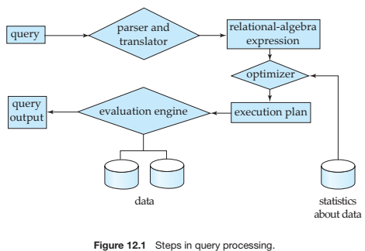
Query processing and query optimization
A query is processed in three general steps:
Parsing and Translation
Query Optimization or planning the execution strategy
Execution in the runtime database processor

Slide 5
Query Optimization or Planning the Execution Strategy
For any given query, there may be a number of different ways to execute it.
Each operation in the query (SELECT, JOIN, etc.) can be implemented using one or more different Access Routines.
For example, an access routine that employs an index to retrieve some rows would be more efficient that an access routine that performs a full table scan.
The goal of the query optimizer is to find a reasonably efficient strategy for executing the query (not quite what the name implies) using the access routines.
Optimization typically takes one of two forms: Heuristic Optimization or Cost Based Optimization
In Heuristic Optimization, the query execution is refined based on heuristic rules for reordering the individual operations.
With Cost Based Optimization, the overall cost of executing the query is systematically reduced by estimating the costs of executing several different execution plans.

Slide 6
Query Code Generator (interpreted or compiled)
Once the query optimizer has determined the execution plan (the specific ordering of access routines), the code generator writes out the actual access routines to be executed.
With an interactive session, the query code is interpreted and passed directly to the runtime database processor for execution.
It is also possible to compile the access routines and store them for later execution.
Execution in the runtime database processor
At this point, the query has been scanned, parsed, planned and (possibly) compiled.
The runtime database processor then executes the access routines against the database.
The results are returned to the application that made the query in the first place.
Any runtime errors are also returned.

Slide 7
Transaction Concept
A transaction is a unit of program execution that accesses and possibly updates various data items.
E.g. transaction to transfer $50 from account A to account B:
read(A)
2. A := A – 50
write(A)
read(B)
5. B := B + 50
6. write(B)
Two main issues to deal with:
Failures of various kinds, such as hardware failures and system crashes
Concurrent execution of multiple transactions

Slide 8
Example of Fund Transfer
Transaction to transfer $50 from account A to account B:
1. read(A)
2. A := A – 50
write(A)
read(B)
5. B := B + 50
6. write(B)
Atomicity requirement
if the transaction fails after step 3 and before step 6, money will be “lost” leading to an inconsistent database state
Failure could be due to software or hardware
– the system should ensure that updates of a partially executed
transaction are not reflected in the database
Durability requirement — once the user has been notified that the transaction has completed (i.e., the transfer of the $50 has taken place), the updates to the database by the transaction must persist even if there are software or hardware failures.

Slide 9
Example of Fund Transfer
Transaction to transfer $50 from account A to account B:
1. read(A)
2. A := A – 50
write(A)
4. read(B)
5. B := B + 50
6. write(B)
Consistency requirement in above example:
A transaction must see a consistent database.
During transaction execution the database may be temporarily inconsistent.
When the transaction completes successfully the database must be consistent
Erroneous transaction logic can lead to inconsistency

Slide 10
Example of Fund Transfer
Isolation requirement — if between steps 3 and 6, another transaction T2 is allowed to access the partially updated database, it will see an inconsistent database (the sum A + B will be less than it should be).
T1
1. read(A)
2. A := A – 50
3. write(A)
T2
read(A), read(B), print(A+B)
4. read(B)
5. B := B + 50
6. write(B)
Isolation can be ensured trivially by running transactions serially
– that is, one after the other.
However, executing multiple transactions concurrently has
significant benefits, as we will see later.

Slide 11
ACID Properties
A transaction is a unit of program execution that accesses and possibly updates various data items.To preserve the integrity of data the database system must ensure:
Atomicity.
Either all operations of the transaction are properly reflected in the database or none are.
Consistency.
Execution of a transaction in isolation preserves the consistency of the database.
Isolation.
Although multiple transactions may execute concurrently, each transaction must be unaware of other concurrently executing transactions. Intermediate transaction results must be hidden from other concurrently executed transactions.
– That is, for every pair of transactions T_{i} and T_{j}, it appears to T_{i} that either T_{j}, finished execution before T_{i} started, or T_{j} started execution after T_{i} finished.
Durability.
After a transaction completes successfully, the changes it has made to the database persist, even if there are system failures.

Slide 12
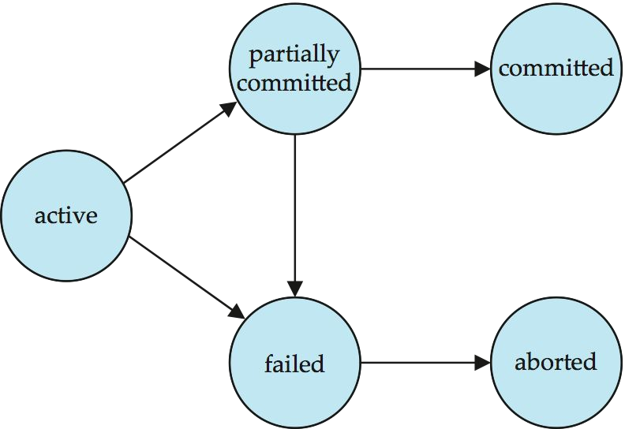
Transaction State Diagram

Slide 13
Transaction State
Active – the initial state; the transaction stays in this state while it is executing
Partially committed – after the final statement has been executed.
Failed -- after the discovery that normal execution can no longer proceed.
Aborted – after the transaction has been rolled back and the database restored to its state prior to the start of the transaction. Two options after it has been aborted:
restart the transaction
can be done only if no internal logical error
kill the transaction
Committed – after successful completion.

Slide 14
Concurrent Executions
Multiple transactions are allowed to run concurrently in the system. Advantages are:
increased processor and disk utilization, leading to better transaction throughput
E.g. one transaction can be using the CPU while another is reading from or writing to the disk
reduced average response time for transactions: short transactions need not wait behind long ones.
Concurrency control schemes – mechanisms to achieve isolation that is, to control the interaction among the concurrent transactions in order to prevent them from destroying the consistency of the database.

Slide 15
Schedules
Schedule – a sequences of instructions that specify the chronological order in which instructions of concurrent transactions are executed
a schedule for a set of transactions must consist of all instructions of those transactions
must preserve the order in which the instructions appear in each individual transaction.
A transaction that successfully completes its execution will have a commit instructions as the last statement
by default transaction assumed to execute commit instruction as its last step
A transaction that fails to successfully complete its execution will have an abort instruction as the last statement

Slide 16
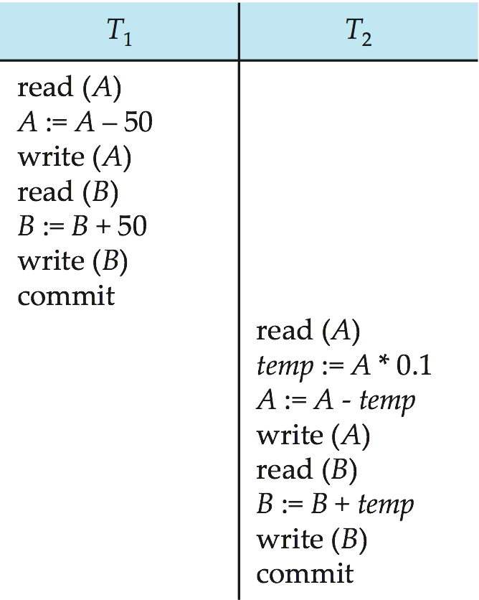
Schedule 1
Let T₁ transfer $50 from A to B, and T₂ transfer 10% of the balance from A to B.
A serial schedule in which T₁ is followed by T₂ :

Slide 17
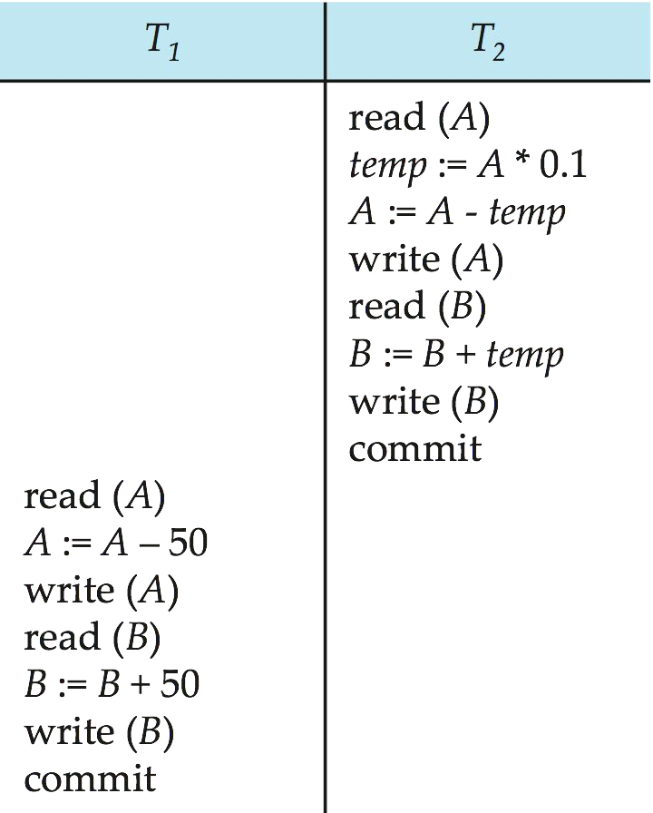
Schedule 2
A serial schedule where T₂ is followed by T₁

Slide 18
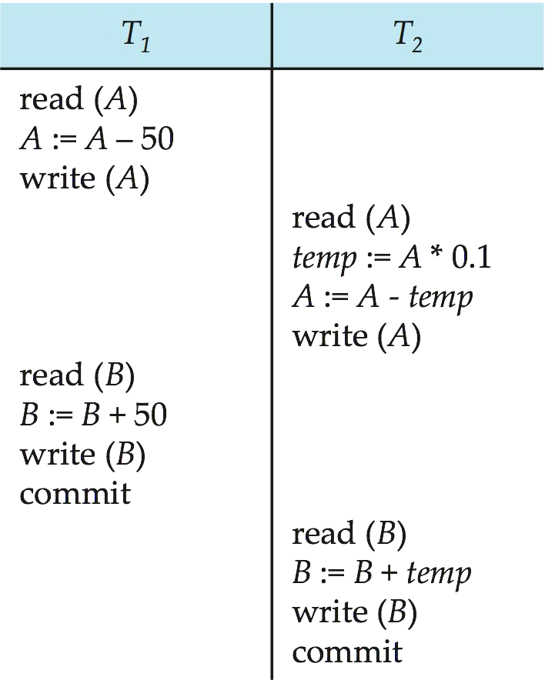
Schedule 3
Let T₁ and T₂ be the transactions defined previously. The following schedule is not a serial schedule, but it is equivalent to Schedule 1.
A = 100
A = 50
Write A = 50
A = 50
temp = 5
A = 45
Write A = 45
B = 10
B = 60
Write B = 60
B = 60
B = 65
Write B = 65
A + B = 110
In Schedules 1 and 2 the sum A + B is preserved.

Slide 19
Serializability
Serializability is a concept that helps us to check which schedules are serializable.
A serializable schedule is the one that always leaves the database in consistent state.
A serial schedule is always a serializable schedule because in serial schedule, a transaction only starts when the other transaction finished execution.
Non-serial schedule may leave the database in inconsistent state so we need to check these non-serial schedules for the Serializability.
Types of Serializability
1. Conflict Serializability-A schedule is called conflict serializable if we can convert it into a serial schedule after swapping its non-conflicting operations.

Slide 20
2. View Serializability-View Serializability is a process to find out that a given schedule is view serializable or not.
We need to check whether given schedule is view equivalent to its serial schedule or not.
To check we need to follow following rules
Read initial value of data item.
Write final value of data item.
Check W->R conflict

Slide 21
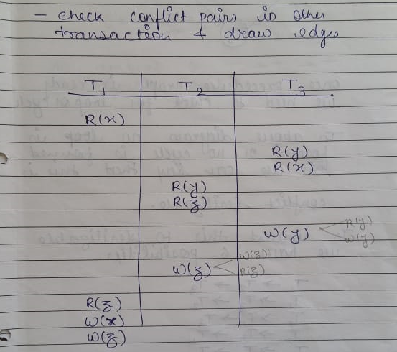
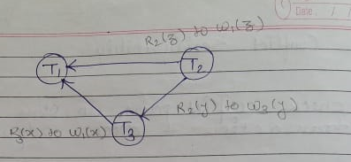
Conflict Serializability A schedule is called conflict serializable if it can be transformed into a serial schedule by swapping non-conflicting operations.

Slide 22
Conflict Serializability
T1->T2->T3
T1->T3->T2
T2->T1->T3
T2->T3->T1
T3->T2->T1
T3->T1->T2.

Slide 23
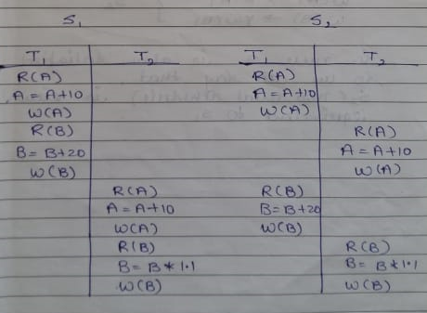
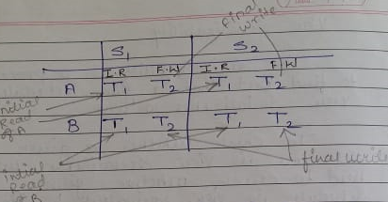
View Serializability
View serializability is a process to find out that a given schedule is view serializable or not
To check we need to follow following rules
Read initial value of data item
Write final value of data item
Check W->R conflict

Slide 24
Recoverable Schedules
Schedules in which transactions commit only after all transactions, whose changes they read commit are called recoverable schedules.
In other words, if some transaction T_{j} is reading value updated or written by some other transaction T_{i}, then the commit of T_{j} must occur after the commit of T_{i}.
There can be three types of recoverable schedule:
1. Cascading Schedule
2. Cascadeless Schedule
3. Strict Schedule

Slide 25
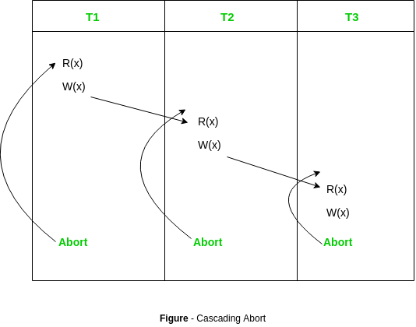
Cascading Rollbacks
Cascading rollback – When there is a failure in one transaction and this leads to the rolling back or aborting other dependent transactions, then such scheduling is referred to as Cascading rollback or cascading abort.

Slide 26
Cascadeless Schedules
Cascadeless schedules — Schedules in which transactions read values only after all transactions whose changes they are going to read commit are called cascadeless schedules.
A strategy to prevent cascading aborts is to disallow a transaction from reading uncommitted changes from another transaction in the same schedule.
T1 T2
R(A)
W(A)
W(A)
Commit
R(A)
Commit
This schedule is cascadeless. Since the updated value of A is read by T₂ only after the updating transaction i.e. T₁ commits.

Slide 27
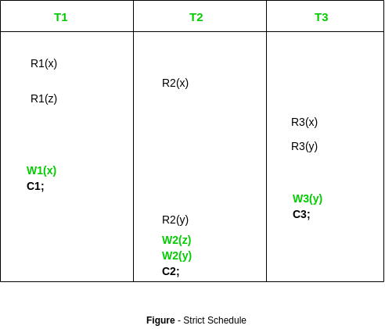
Strict Schedule
A schedule is strict if a value written by a transaction can not be read or overwritten by other transactions until the transaction either commit or abort.
Or
if schedule contains no read or write before commit then it is known as strict schedule. Strict schedule is strict in nature.
In this schedule no read-write or write-write conflict arises before commit hence its strict schedule

Slide 28
Non recoverable Schedules
Consider the following schedule involving two transactions T₁ and T₂.
T1 T2
R(A)
W(A)
R(A)
Commit
Abort
T₂ read the value of A written by T₁, and committed. T₁ later aborted, therefore the value read by T₂ is wrong, but since T₂ committed, this schedule is non-recoverable

Slide 29
Concurrency Control
Concurrency control is the procedure in DBMS for managing simultaneous operations without conflicting with each another.
In the concurrency control, the multiple transactions can be executed simultaneously.
It may affect the transaction result. It is highly important to maintain the order of execution of those transactions.
Problems of concurrency control
Several problems can occur when concurrent transactions are executed in an uncontrolled manner.
Following are the three problems in concurrency control.
Lost updates
Dirty read
Unrepeatable read

Slide 30
Concurrency Control (Cont.)
Lost update problem
When two transactions that access the same database items contain their operations in a way that makes the value of some database item incorrect, then the lost update problem occurs.
If two transactions T1 and T2 read a record and then update it, then the effect of updating of the first record will be overwritten by the second update.
Dirty Read
The dirty read occurs in the case when one transaction updates an item of the database, and then the transaction fails for some reason. The updated database item is accessed by another transaction before it is changed back to the original value.
A transaction T1 updates a record which is read by T2. If T1 aborts then T2 now has values which have never formed part of the stable database.

Slide 31
Inconsistent Retrievals Problem / Unrepeatable read
Inconsistent Retrievals Problem is also known as unrepeatable read. When a transaction calculates some summary function over a set of data while the other transactions are updating the data, then the Inconsistent Retrievals Problem occurs.
A transaction T1 reads a record and then does some other processing during which the transaction T2 updates the record. Now when the transaction T1 reads the record, then the new value will be inconsistent with the previous value.

Slide 32
Concurrency Control Protocol
Different concurrency control protocols offer different benefits between the amount of concurrency they allow and the amount of overhead that they impose.
1. Lock-Based Protocols
2. Two Phase
3. Timestamp-Based Protocols
4. Validation-Based Protocols
1. Lock-Based Protocol
In this type of protocol, any transaction cannot read or write data until it acquires an appropriate lock on it. All lock requests are made to the concurrency-control manager. Transactions proceed only once the lock request is granted.
There are two types of lock:
i. Shared lock
ii. Exclusive lock

Slide 33
i. Shared lock (S Lock) -
A shared lock is also called a Read-only lock. With the shared lock, the data item can be shared between transactions. This is because you will never have permission to update data on the data item.
For example, consider a case where two transactions are reading the account balance of a person. The database will let them read by placing a shared lock. However, if another transaction wants to update that account's balance, shared lock prevent it until the reading process is over.
ii. Exclusive lock (X Lock) –
In the exclusive lock, the data item can be both reads as well as written by the transaction.
This lock is exclusive, and in this lock, multiple transactions do not modify the same data simultaneously.
For example, when a transaction needs to update the account balance of a person. You can allows this transaction by placing X lock on it. Therefore, when the second transaction wants to read or write, exclusive lock prevent this operation.

Slide 34
2. Two Phase
In this type of locking protocol, the transaction should acquire a lock after it releases one of its locks.
The Two-Phase Locking protocol allows each transaction to make a lock or unlock request in two steps:
Growing Phase: In this phase transaction may obtain locks but may not release any locks.
Shrinking Phase: In this phase, a transaction may release locks but not obtain any new lock

Slide 35
3. Timestamp-Based Protocols-
The timestamp-based algorithm uses a timestamp to serialize the execution of concurrent transactions.
This protocol ensures that every conflicting read and write operations are executed in timestamp order.
The protocol uses the System Time or Logical Count as a Timestamp.
The older transaction is always given priority in this method

Slide 36
4.Validation-Based Protocols
This protocol is used in DBMS for avoiding concurrency in transactions.
The three phases for validation based protocol:
Read phase: In this phase, the transaction T is read and executed. It is used to read the value of various data items and stores them in temporary local variables.
Validation Phase: In this phase, the temporary variable value will be validated against the actual data, to make sure that there is no violation of serializability.
Write phase: If the validation of the transaction is validated, then the temporary results are written to the database otherwise, the updates are discarded and the transaction is rolled back.

Slide 37
Concurrency Control vs. Serializability Tests
Concurrency-control protocols allow concurrent schedules, but ensure that the schedules are conflict/view serializable, and are recoverable and cascadeless .
Concurrency control protocols generally do not examine the precedence graph as it is being created
Instead a protocol imposes a discipline that avoids nonseralizable schedules.
Different concurrency control protocols provide different tradeoffs between the amount of concurrency they allow and the amount of overhead that they incur.
Tests for serializability help us understand why a concurrency control protocol is correct.

Slide 38
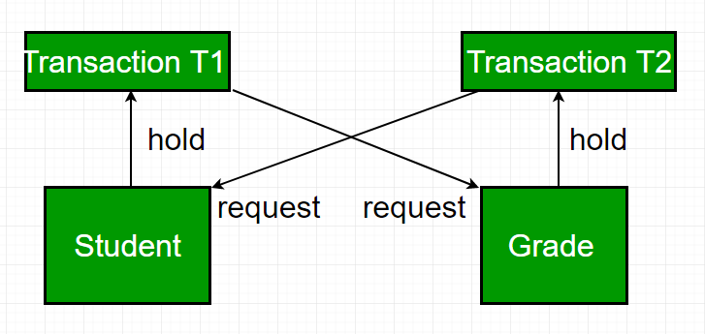
Deadlocks
In a database, a deadlock is an unwanted situation in which two or more transactions are waiting indefinitely for one another to give up locks.
Suppose, Transaction T1 holds a lock on some rows in the Students table and needs to update some rows in the Grades table. Simultaneously, Transaction T2 holds locks on those very rows (Which T1 needs to update) in the Grades table but needs to update the rows in the Student table held by Transaction T1.
Now, the main problem arises. Transaction T1 will wait for transaction T2 to give up lock, and similarly transaction T2 will wait for transaction T1 to give up lock.

Slide 39
Implementation of Locking
A lock manager can be implemented as a separate process to which transactions send lock and unlock requests
The lock manager replies to a lock request by sending a lock grant messages (or a message asking the transaction to roll back, in case of a deadlock)
The requesting transaction waits until its request is answered
The lock manager maintains a data-structure called a lock table to record granted locks and pending requests
The lock table is usually implemented as an in-memory hash table indexed on the name of the data item being locked

Slide 40
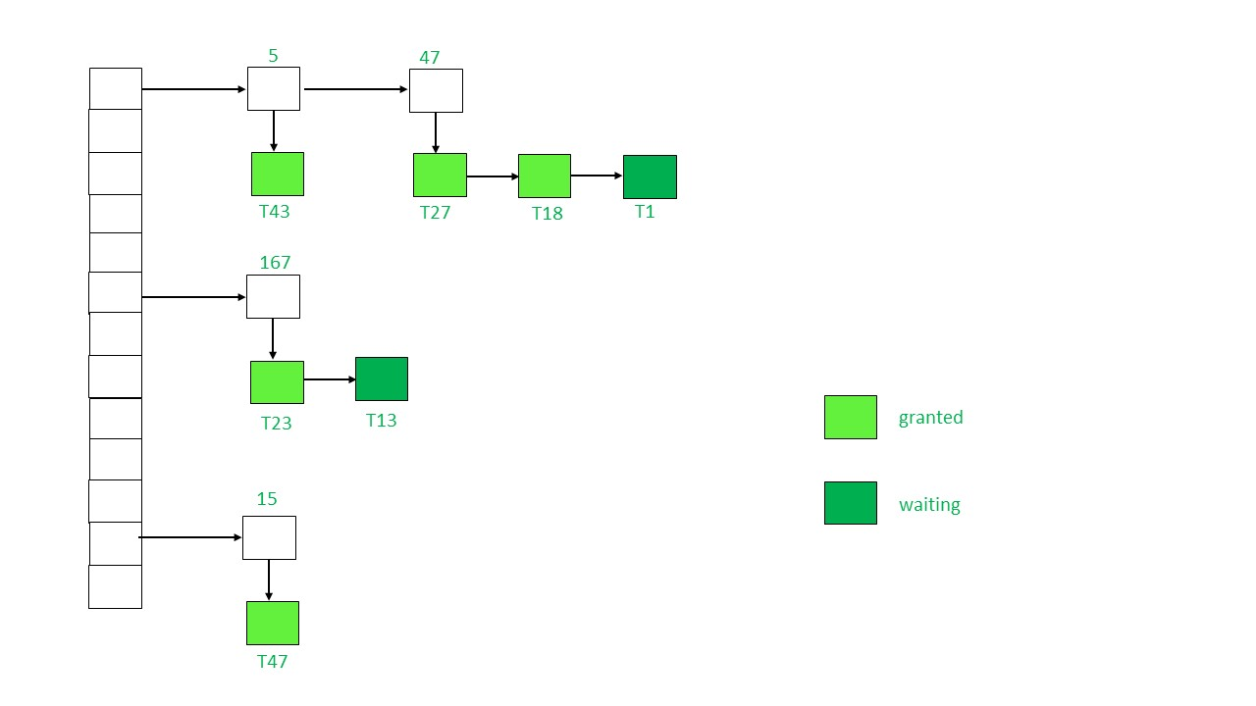
Lock Table

Slide 41
Initially the lock table is empty as no data item is locked.
Whenever lock manager receives a lock request from a transaction T_{i} on a particular data item Q_{i} following cases may arise:
If Q_{i} is not already locked, a linked list will be created and lock will be granted to the requesting transaction T_{i}.
If the data item is already locked, a new node will be added at the end of its linked list containing the information about request made by T_{i}.
If the lock mode requested by T_{i} is compatible with lock mode of transaction currently having the lock, T_{i} will acquire the lock too and status will be changed to ‘granted’. Else, status of T_{i}’s lock will be ‘waiting’.
If a transaction T_{i} wants to unlock the data item it is currently holding, it will send an unlock request to the lock manager. The lock manager will delete T_{i}’s node from this linked list. Lock will be granted to the next transaction in the list.
Sometimes transaction T_{i} may have to be aborted. In such a case all the waiting request made by T_{i} will be deleted from the linked lists present in lock table. Once abortion is complete, locks held by T_{i} will also be released.

Slide 42
Deadlock Handling
System is deadlocked if there is a set of transactions such that every transaction in the set is waiting for another transaction in the set.
Deadlock prevention protocols ensure that the system will
never enter into a deadlock state. Some prevention strategies :
Require that each transaction locks all its data items before it begins execution (predeclaration).
Impose partial ordering of all data items and require that a transaction can lock data items only in the order specified by the partial order.

Slide 43
More Deadlock Prevention Strategies
Following schemes use transaction timestamps for the sake of deadlock prevention alone.
wait-die scheme — non-preemptive
older transaction may wait for younger one to release data item. (older means smaller timestamp) Younger transactions never wait for older ones; they are rolled back instead.
a transaction may die several times before acquiring needed data item
wound-wait scheme — preemptive
older transaction wounds (forces rollback) of younger transaction instead of waiting for it. Younger transactions may wait for older ones.
may be fewer rollbacks than wait-die scheme.

Slide 44
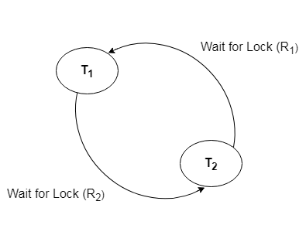
Deadlock Detection
In a database, when a transaction waits indefinitely to obtain a lock, then the DBMS should detect whether the transaction is involved in a deadlock or not.
The lock manager maintains a wait-for the graph to detect the deadlock cycle in the database.
The system is in a deadlock state if and only if the wait-for graph has a cycle. Must invoke a deadlock-detection algorithm periodically to look for cycles.

Slide 45
Deadlock Recovery
Deadlock recovery is generally used when deadlocks are rare and the cost of recovery is low.
Methods for Recovery
Termination of processes
Some victim process is chosen for termination from the cycle of deadlocked processes.
This process is terminated, requiring a later restart All the resources allocated to this processes are released, so that they may be reassigned to other deadlocked processes
2. Rolling back processes
In order to rollback a victim process, there needs to have been some previous checkpoint at which time the state of the victim process was saved to stable storage
There must also be an assurance that the rolled back process is not holding any resource needed by the other deadlocked processes at that point.
Starvation happens if same transaction is always chosen as victim. Include the number of rollbacks in the cost factor to avoid starvation

Slide 46
Failure Classification
Transaction failure :
Logical errors: transaction cannot complete due to some internal error condition
System errors: the database system must terminate an active transaction due to an error condition (e.g., deadlock)
System crash: a power failure or other hardware or software failure causes the system to crash.
Disk failure: a head crash or similar disk failure destroys all or part of disk storage
Destruction is assumed to be detectable: disk drives use checksums to detect failures

Slide 47
Recovery and Atomicity
To ensure atomicity despite failures, we first output information describing the modifications to stable storage without modifying the database itself.
log-based recovery mechanisms-
The log is a sequence of records. Log of each transaction is maintained in some stable storage so that if any failure occurs, then it can be recovered from there.
If any operation is performed on the database, then it will be recorded in the log.

Slide 48
Log-Based Recovery
A log is kept on stable storage.
– The log is a sequence of log records, and maintains a record of update activities on the database.
When transaction T_{i} starts, it registers itself by writing a
<T_{i} start>log record
Before T_{i} executes write(X), a log record
<T_{i}, X, V₁, V₂>
is written, where V₁ is the value of X before the write (the old value), and V₂ is the value to be written to X (the new value).

Slide 49
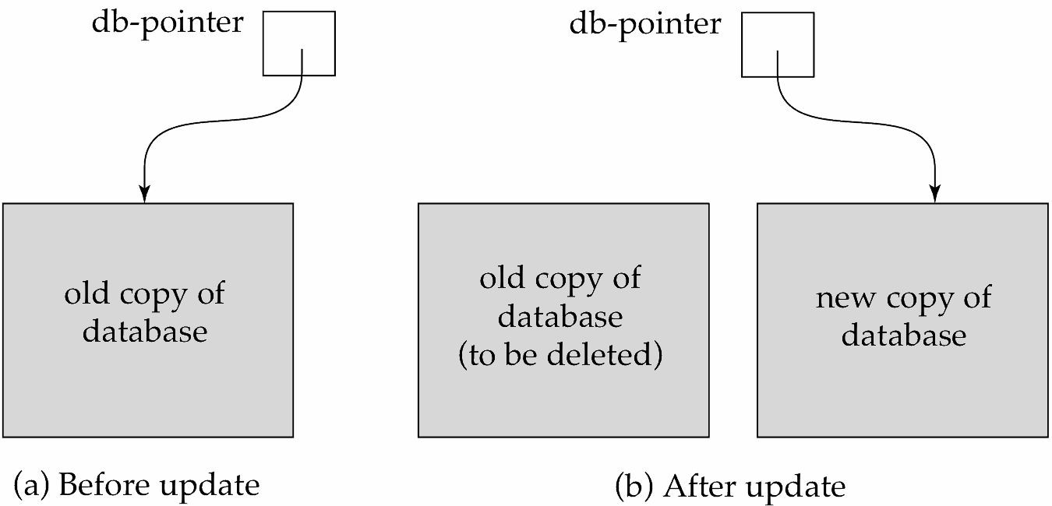
Shadow-copy and Shadow-paging
This is the method where all the transactions are executed in the primary memory or the shadow copy of database.
Once all the transactions completely executed, it will be updated to the database.
if there is any failure in the middle of transaction, it will not be reflected in the database. Database will be updated after all the transaction is complete.

Slide 50
Checkpoints
The checkpoint is a type of mechanism where all the previous logs are removed from the system and permanently stored in the storage disk.
Checkpoint declares a point before which the DBMS was in consistent state, and all the transactions were committed.
The recovery system reads the logs backwards from the end to the last checkpoint.
It maintains two lists, an undo-list and a redo-list.
If the recovery system sees a log with <tn, start=""> and <tn, commit=""> or just <tn, commit="">, it puts the transaction in the redo-list.
If the recovery system sees a log with <tn, start=""> but no commit or abort log found, it puts the transaction in undo-list.
All the transactions in the undo-list are then undone and their logs are removed.
All the transactions in the redo-list and their previous logs are removed and then redone before saving their logs.

Slide 51
Checkpoints (Cont.)
During recovery we need to consider only the most recent transaction T_{i} that started before the checkpoint, and transactions that started after T_{i}.
Scan backwards from end of log to find the most recent
<checkpoint L> record
Only transactions that are in L or started after the checkpoint need to be redone or undone
Transactions that committed or aborted before the checkpoint already have all their updates output to stable storage.
Some earlier part of the log may be needed for undo operations
Continue scanning backwards till a record <T_{i} start> is found for every transaction T_{i} in L.
Parts of log prior to earliest <T_{i} start> record above are not needed for recovery, and can be erased whenever desired.

Slide 52
Questions
What are the main steps involved in query processing, and why is query optimization important?
Explain the ACID properties of transactions and their significance in database management systems.
Differentiate between a serial schedule and a concurrent schedule. What are the advantages and challenges of each?
What is serializability in the context of transaction schedules? How can conflict serializability be determined using a precedence graph?
Discuss the concept of cascaded aborts in transaction management and its impact on database consistency.
Define recoverable and non-recoverable schedules. What are the criteria for determining whether a schedule is recoverable?
Why is concurrency control necessary in multi-user database environments? Describe the locking-based protocol for concurrency control.
What are deadlocks, and why are they a concern in concurrent systems? Explain prevention and detection techniques for handling deadlocks.
Compare and contrast shadow paging and log-based recovery methods. Discuss their advantages and limitations.
How does the write-ahead logging protocol ensure durability in transaction recovery? Explain the purpose of redo and undo operations in log-based recovery.
What is the role of checkpoints in recovery and concurrency control? Discuss different types of checkpoints and their implementation.
How does cost-based query optimization work? Describe the factors considered and the goal of the optimization process.

